Slide 2
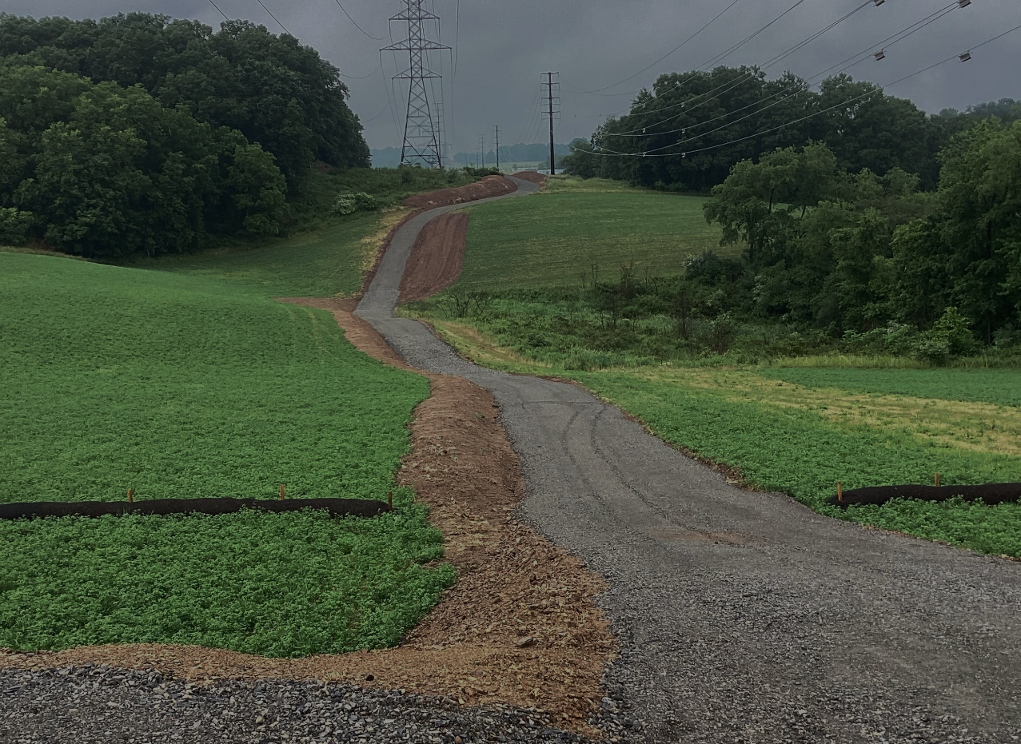
Process Overview

Slide 3
Potential Approaches
Targeted Solicitation
Controlled Auction
Broad Auction
Description
High-level approach to selected prospective buyers
Executive summary-type management presentation
Establish a limited universe of logical prospective buyers
Utilize a confidential information memorandum (“CIM”)
Contact wide range of highly relevant and “outside of the box” prospective buyers
Utilize a confidential information memorandum (“CIM”)
No. Targets
Typically 2-15 parties
Typically 50-80 parties
Typically greater than 125+ parties
Rationale
Clear sense of logical buyers
Maintains confidentiality and limits business disruption
Create competition among small group of attractive buyers
Speed of execution with a market test
Larger group of logical potential buyers
Provides balance between time, confidentiality and value
Enables competitive process
Difficulty identifying which buyers are most-likely to “pay up”
Focus on maximizing shareholder value
Approach
Limited high-level discussions with no prior dissemination of CIM
Executive summary presentation followed by financial diligence package
Move to deeper Mgt. presentations
Limited disclosure of process
Sensitive information withheld until late in process; provided to serious bidders
Parties submit proposals based on CIM, most attractive buyers meet with Mgt.
General acknowledgement of process
Sensitive information withheld until late in process; provided to serious bidders
Parties submit proposals based on CIM, most attractive buyers meet with Mgt.
Time to Close
3-5 months
6-7 months
8-10+ months
Advantages
Speed of execution with market test; confidentiality maintained
Limited business disruption
Creates sense of competition
Avoids perception of being “shopped”
Accurate test of market price
Creates strong sense of competition
Balances speed of execution with risk of excluding non-obvious buyers
Ability to dictate terms & maximize value
Heightens sense of competition among buyers
Finds “hidden” buyers
Full market test of market price
Disadvantages
Risks missing non-obvious buyers
Risk of impairing competitive bidding if key buyers exit process or show weak interest
Requires more top-level management time commitment
Limited confidentiality
Potential business disruption
Relatively long execution process
Greater risk of access to competitive information by “tire-kickers”
Highest risk of business disruption
Least amount of confidentiality

Slide 4
Illustrative Transaction Timeline
Mufson Howe Hunter’s approach to the transaction process is designed to ensure confidentiality, minimize business disruptions and encourage a competitive environment in order to maximize value for our clients on the most favorable terms.
Transaction responsibilities are typically shared among the Mufson Howe Hunter deal team, the Company, Company accountants and Company legal counsel. The MHH team leads the majority of the Pre-Marketing and Marketing phases in order to minimize the time needed from the Company and its advisors.

Slide 5

Pre-Marketing Phase: Due Diligence
We kick off the pre-marketing stage with an extensive due diligence process, during which we would schedule several working sessions to discuss our client’s business model and financial results in greater detail so we can build a stronger understanding of the Company.
Our key focus for financial diligence (historical operating results, pro forma adjustments, seller QoE analysis and projections) and business diligence (clients, sales & marketing, competition, management & employees) are summarized below:
Pro Forma Adjustments
Historical Operating Results
Overlapping employees
Above average compensation
Non-recurring expenses
Timing adjustments
Opportunities for synergies
Seller QoE Analysis
Annual revenue growth
Trends in profitability margins
Financial condition
A de facto standard within M&A sector
Prep work minimizes QoE costs
Allows seller to control accounting narrative
Translates into more confident buyers
Management & Employees
Projections
Overall quality of management
Experience, leadership, creativity
Recruiting / retention of employees
Skill sets of professional employees
Customary 5-year forecasts
Detailed revenue mix
Pricing model
Key metrics / value drivers
Reasonableness / sensitivity
Competition
Clients
Barriers to entry
Degree to which they compete
Proprietary knowledge, processes & analytical tools
Sales & Marketing
Concentration
Growth in client services
Longevity of clients
Retention rate
Key relationships
Marketing / sales cycle
Marketing / sales leadership
Revenue pipeline forecast & backlog visibility

Slide 6
Quality of Earnings Adjustment Examples
Below are some common quality of earnings adjustments to consider:
Normalizing
Accounting or “GAAP”
Pro forma
Unusual professional and legal fees
Transaction expenses
Owner/personal expenses
Management fees
Out-of-period revenue and expenses
FMV adjustments (e.g., compensation, rent)
Discretionary expenses
FMV of related-party activities
Nonrecurring expenses or revenue
Gain/loss on sale of assets
Unusual write-offs or accrual reversals
Relocation costs or recruiting fees
Employees who will not continue
Severance costs
Noncash income or expense
Percentage of completion accounting adjustments
Cash-to-accrual
Accounting policy change
Capitalizable expenses charged to repairs and maintenance, or other expense account
Reserve adjustments (e.g., accounts receivable, inventory, warranty, gift card or rebate)
Unconsolidated related parties
GAAP departures in revenue recognition or inventory accounting
Unrecorded audit adjustments
Recent acquisitions/divestitures
Implemented cost-cutting initiatives
Increased pricing
Carve-out and cost allocation
Insourcing of production
New/closed facilities
New/lost customers
New product lines
"Start-up" costs
Normalizing or run-rate adjustments (e.g., change in experience rates for insurance costs, medical claims, benefits, owners’ compensation, rental arrangements and vendor terms)

Slide 7
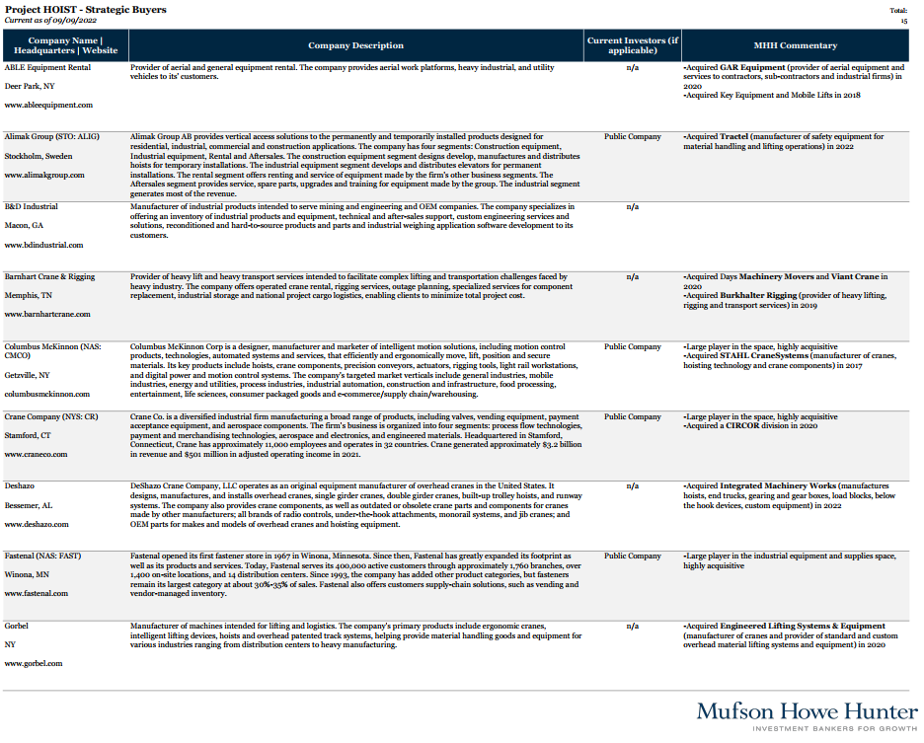
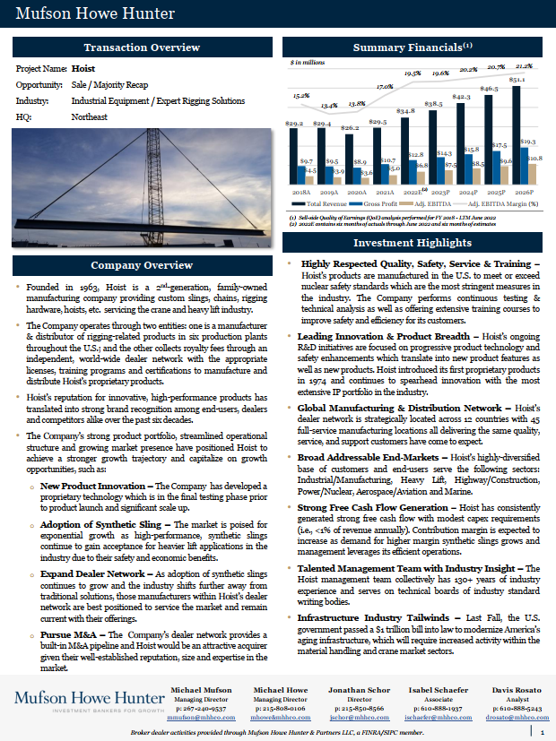
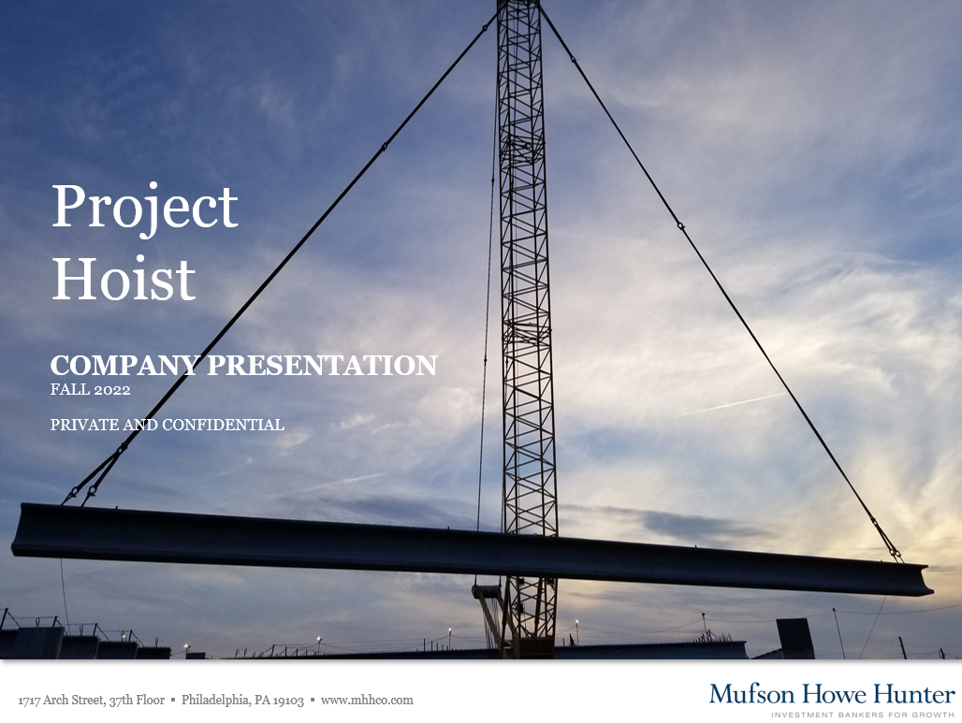
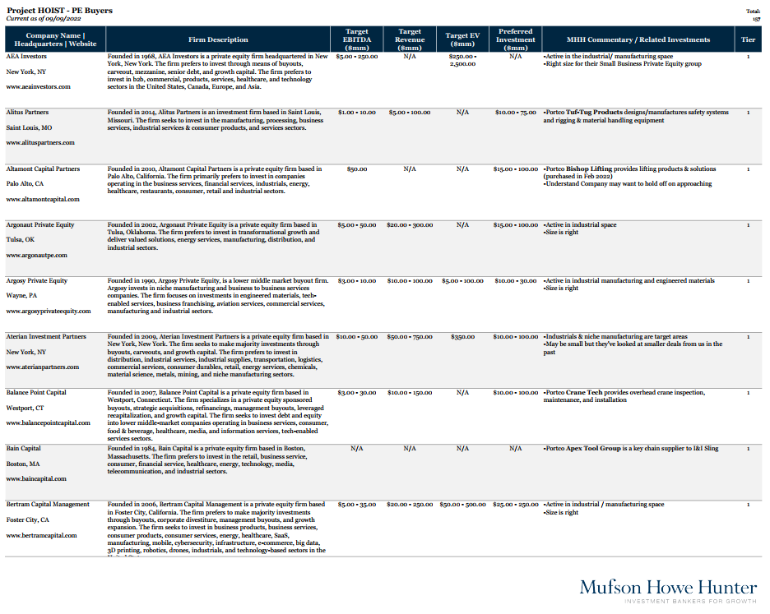
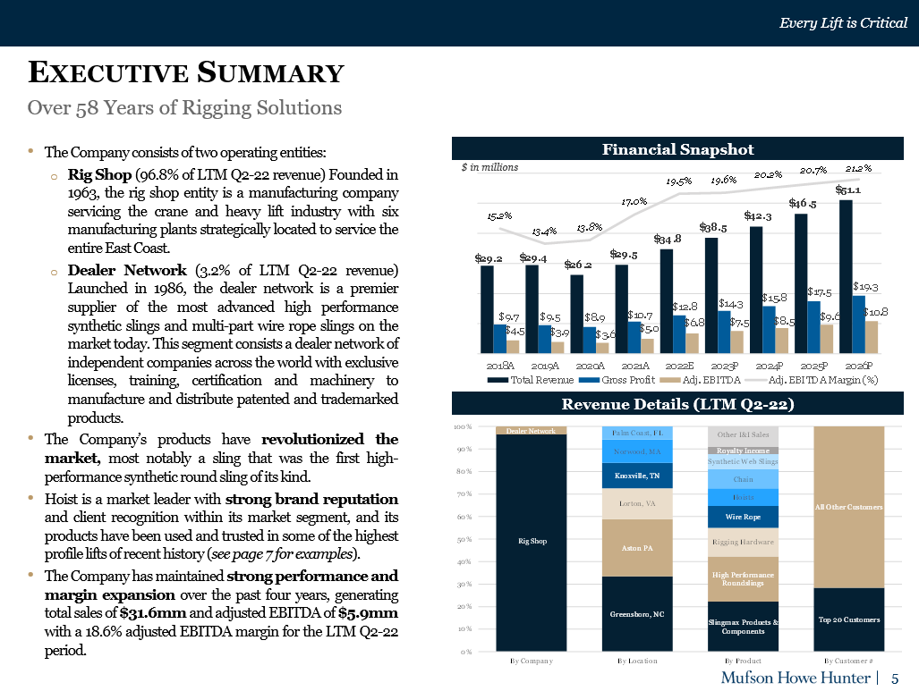
Pre-Marketing Phase: Document Drafting
Our due diligence working sessions allow us to start drafting the following key marketing documents:
Financial model with customary five-year projections and pro forma expenses built in, reflecting findings from the seller QoE analysis
Buyers List of thorough, carefully-curated potential investors consisting of both financial sponsors and strategic industry players
Teaser presenting a high-level one-page overview of the opportunity on a no-names basis – this is the first document that would be shared with potential buyers to gauge interest and determine if they would like to learn more
Non-Disclosure Agreement (NDA) with approval from Company counsel – to be executed after reviewing of a teaser in order to then receive the CIM
Confidential Information Memorandum (CIM) presenting a detailed overview of the Company’s investment highlights, business model, financial results and outlook -- essentially everything a potential buyer would need in order to submit an initial offer
Buyers List
Teaser
CIM

Slide 8
Marketing Phase
During the marketing phase, we focus on executing a thoughtful, comprehensive marketing process designed to identify the strongest potential partners and induce a premium valuation, while prioritizing confidentiality and efficiency.
Other than management meetings, we strive to handle a majority of the diligence questions ourselves in order to minimize burden/disruption to our clients. That being said, we also keep the process well-documented so that we can share thorough status updates with our client on a regular basis to keep them in the loop throughout the entire phase.
The key steps of our process include:
Initial Outreach
IOI Phase
LOI Phase
Managing Directors & Directors initiate contact
Collect & review non-binding IOIs
Collect and review LOIs
Send follow-up email with the teaser and NDA attached
Open pre-LOI data room with additional information
Update data room for any additional information needed
Negotiate and execute NDA
Invite 3-6 buyers to management meetings
Negotiate LOI terms to collect best & final offers
Send CIM & Indication of Interest (IOI) process letter
Prepare Management Presentation (MP) & assist in team practice runs / preparation
MHH holds follow-up calls/virtual meetings with interested parties
Host management meetings
Select buyer & execute LOI

Slide 9
Closing Phase
Once the LOI has been signed, we work closely with our client and their counsel/accountants to navigate the closing process as smoothly and efficiently as possible. We interface directly with the buyer and their third-party vendors to facilitate the buy-side diligence efforts, document drafting and negotiations and strategy discussions.
Though this phase inevitably requires a higher level of involvement from the client in terms of information gathering, we quarterback all of the workstreams and analyze/organize all of the data in order to take as much of the heavy lifting off of the client as possible.
The key elements of the closing process are summarized below, the order of which can vary as they often overlap (other than the buy-side QoE which is almost always the first step):
Buyer Due Diligence
Document Drafting & Negotiation
Strategy Discussions
MHH works with Buyer’s QoE provider to complete buy-side QoE report
Draft and negotiate purchase agreement, including disclosure schedules
Management team & Buyer discuss post-close roles and operating initiatives
Buyer engages third-party vendors to perform in-depth insurance, HR/benefits, IT and environmental diligence reports
Draft and negotiate ancillary documents such as employment agreements and financing documents
Management team & Buyer discuss integration plans
Buyer conducts business and operations diligence
Draft and negotiate working capital peg and funds flow waterfall
Management team & Buyer discuss potential acquisition opportunities
CLOSE

Slide 10

MUFSON HOWE HUNTER
About Us
Mufson Howe Hunter focuses on mergers & acquisitions and private capital raising for middle-market companies in the business and industrial services sectors. MHH serves as a trusted advisor to middle-market companies throughout their lifecycle: from raising early-stage growth capital, to later-stage recapitalizations, to maximizing value upon the sale of the business.
Washington, D.C. Office
Joe Golden, Managing Director
7940 Jones Branch Dr. Suite 400
Tyson, VA 22102
(703) 785-5525
Philadelphia ▪ Washington, D.C. ▪ Atlanta
www.mhhco.com

